Slide 1

Dr. Cheryl Seals' Faculty Website
COMP 5620: User Interface Design and Evaluation
Group Members: Ghaday Alsulaimani, Nicholas Winfrey, Lily Edgil, Matthew Glass

Slide 2
Project Abstract
This project focuses on analyzing and redesigning Dr. Seals' existing faculty webpage to improve its overall user interface (UI) and user experience (UX).
Key Objectives:
Make the site more accessible.
Make it visually engaging.
Make it intuitive for students, faculty, and visitors.
Dr. Cheryl Seals is a Professor of Computer Science and Software Engineering at Auburn University. She is a leader in the intersection of Artificial Intelligence (AI), education, and design ethics , and has extensive experience in User Interface and Design.

Slide 3
Software Development Process & Tools
Software Development Process:
Development Cycle:
Tools Utilized:
We used the Scrum Agile process.
Focuses on short, iterative sprints.
Includes frequent feedback from Dr. Seals.
Ensures the redesign evolves through collaboration and continuous improvement.
Each sprint includes planning, design, testing, and refinement.
Project Management: Scrum (for workflow organization).
Design/Prototyping: Canva , Figma.
Hardware: Computer, Mouse, Keyboard.

Slide 4
Conceptual Model
Interface Metaphor: Dr. Seals' Virtual Office.
It should feel like walking into her workspace: welcoming, organized, and full of information.
Each section acts like a part of her office where students/colleagues can learn or reach out.
Interaction Type: Exploring.
The user instructs the system by scrolling and clicking button links.

Slide 5
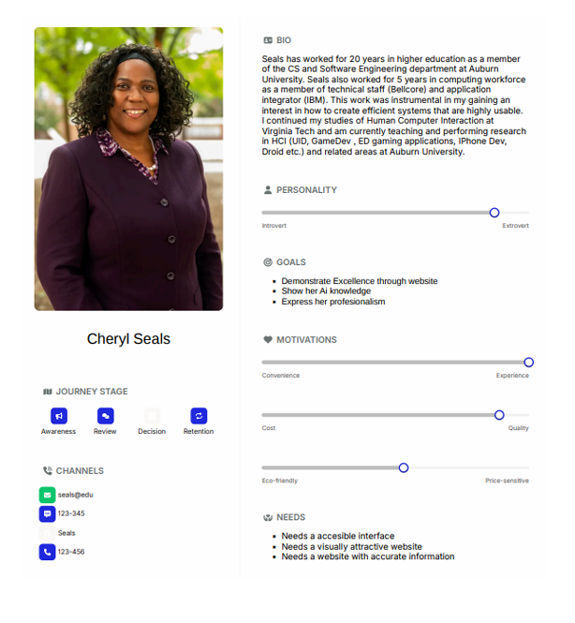
Persona
Key Goals: Demonstrate excellence through the website, show her AI knowledge, and express her professionalism.
Key Needs: A website with an accessible interface, a visually attractive website, and a site with accurate information.

Slide 6
Empathy Map
SAYS
This is a nice website
Everything is really easy to find
She seems very knowledgeable
DOES
Navigates the pages
Moves Mouse
Scrolls on webpage
Where is her contact information
She has alot of achivements
FEELS
Impressed with the user interface
Satisfied as everything is easy to find
Challenged trying to go through the information

Slide 7
High-Level Mochup
Prototype Overview: The following shows the redesigned homepage/navigation, implementing the clear structure required for user success.
Key Design Features Shown:
Clear main navigation bar (Bio, Research, Publications, Teaching).
Prominent display of contact/office information (Email, Location, Office hours).
Dedicated area for her professional photo and title.
Development Tools: Prototype developed using Figma and Canva.

Slide 8
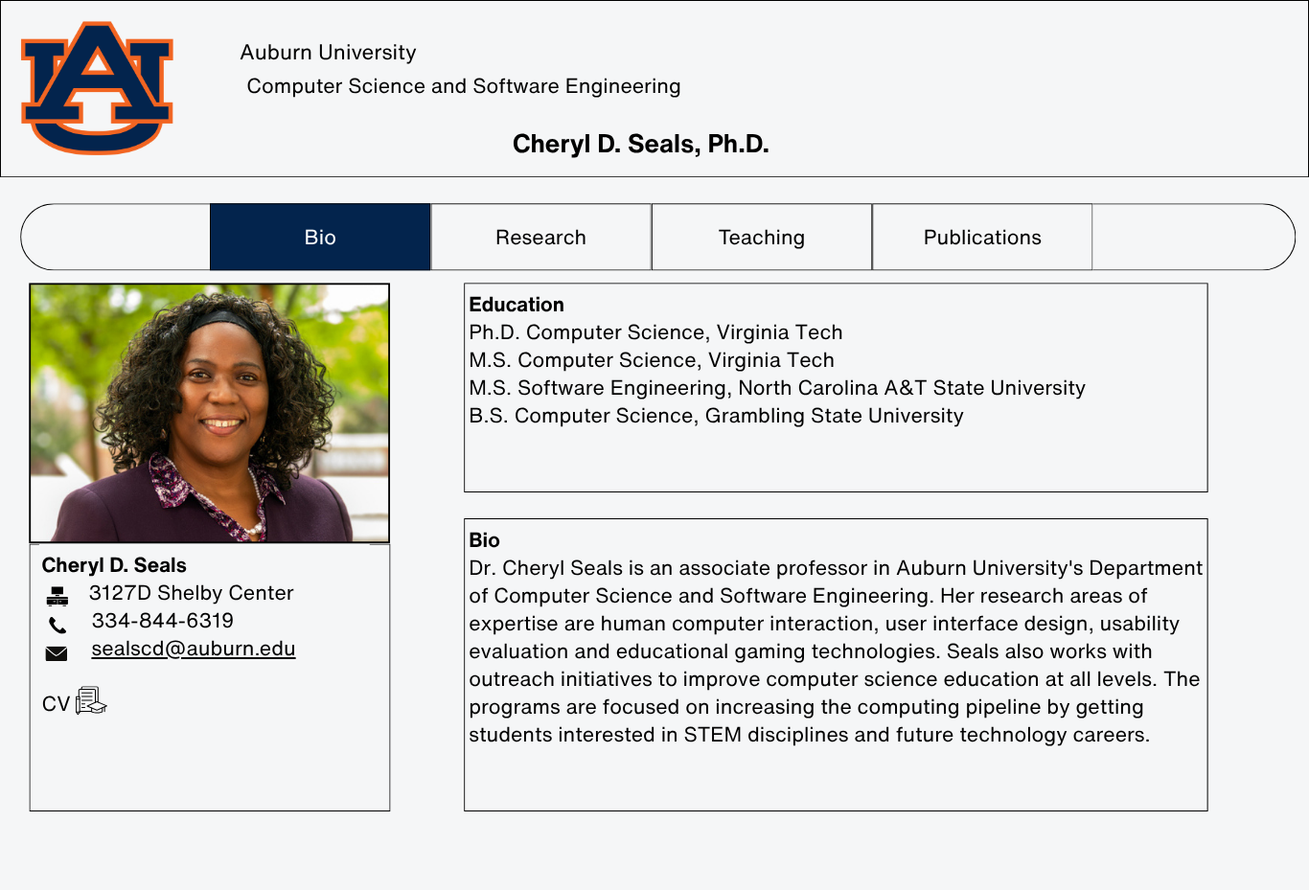

Slide 9
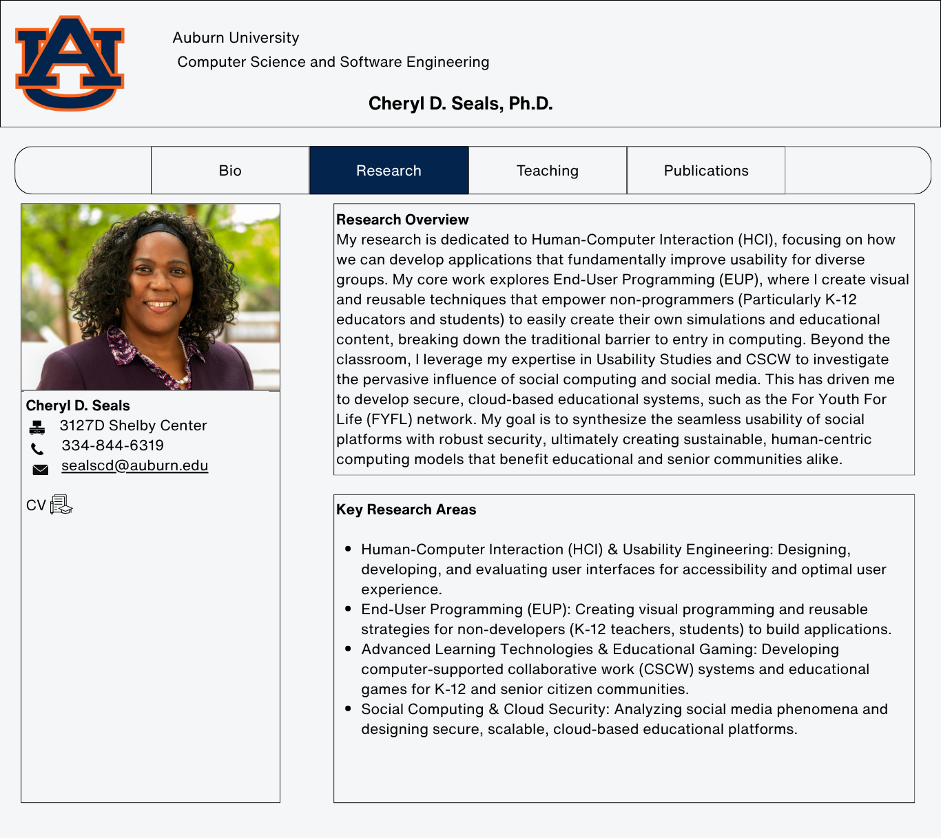

Slide 10
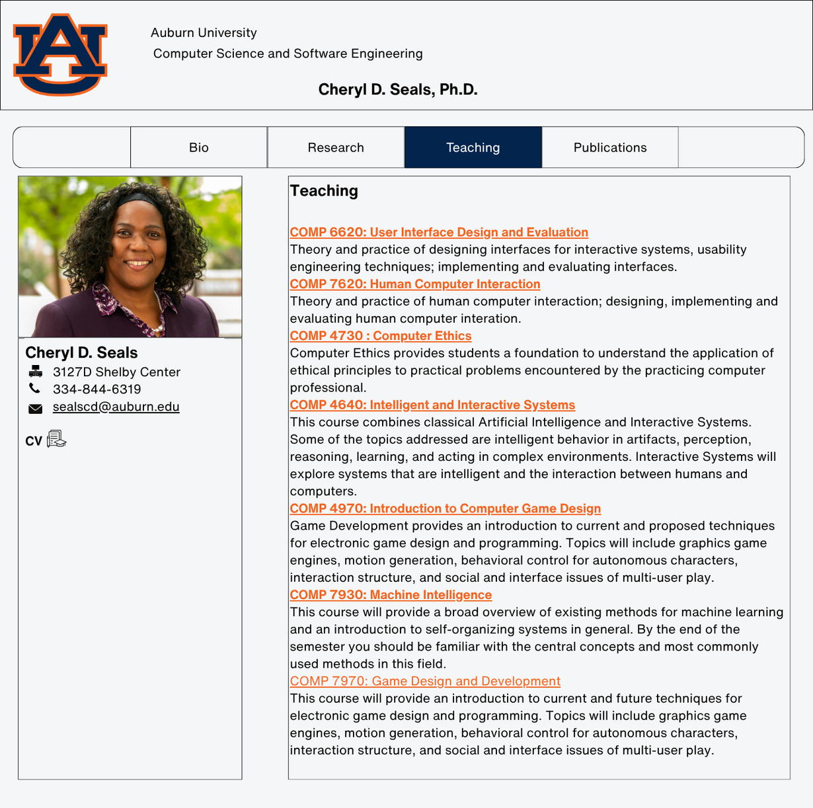

Slide 11
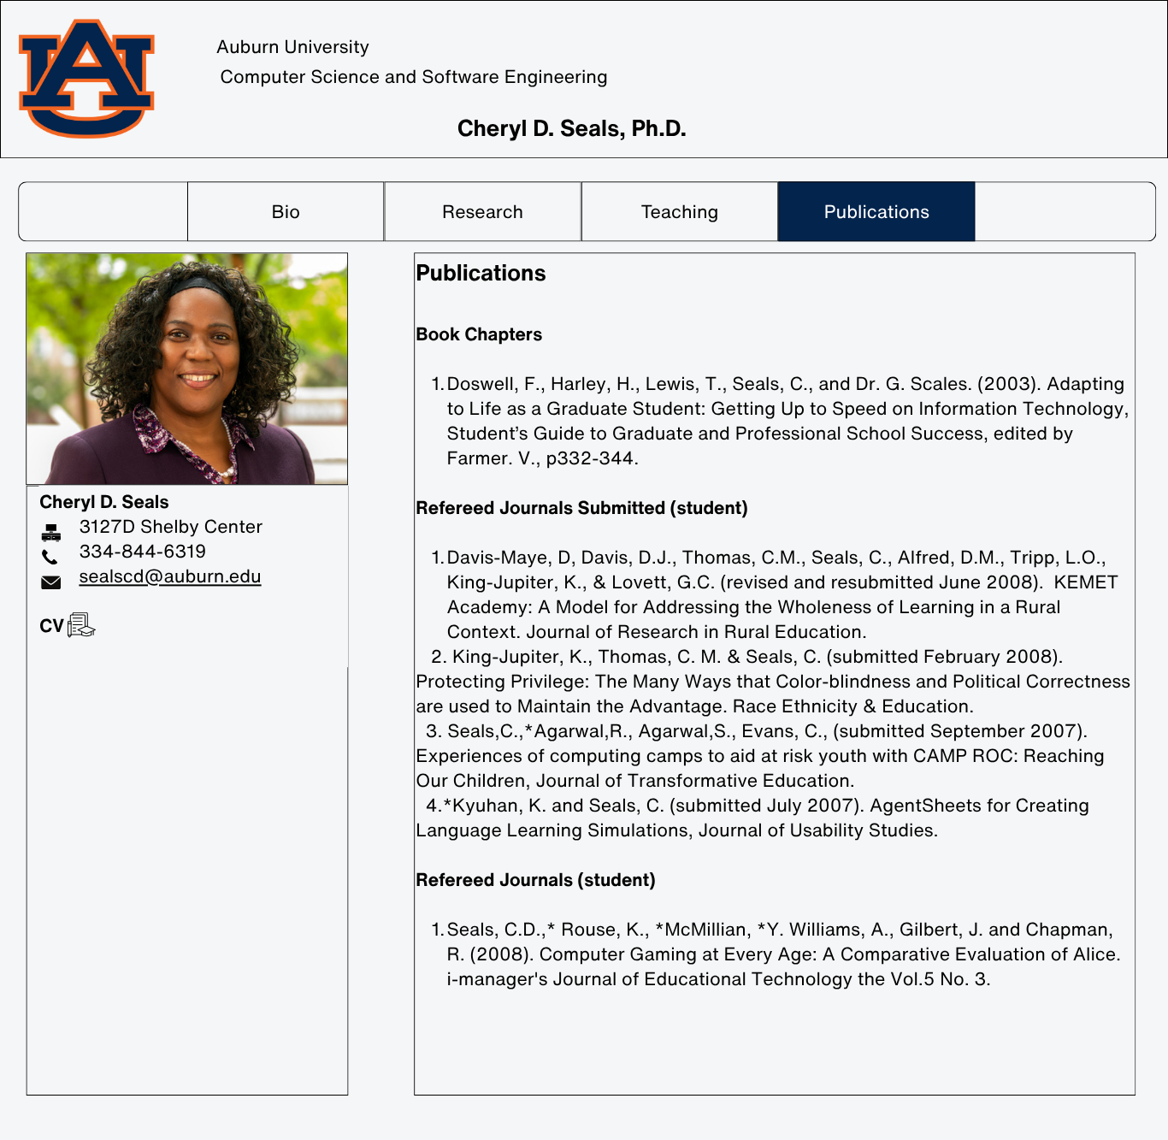

Slide 12
Scenario 1
Scenario: Josh, a new student, needs to quickly locate and download the syllabus for COMP 5620: UI Design & Eval.
User Flow:
Navigates to Dr. Seals' page.
Clicks the "Teaching" tab.
Locates the course under the "Teaching" list.
Clicks the course name, then find the Syllabus.
Functional Requirements Met:
System includes a dedicated "Teaching" section listing courses.
System allows the faculty member to upload and link required course documents (the syllabus).

Slide 13
Scenario 2
Scenario: Alex finds Dr. Seals' page and scans for information on Research, Publications, and her AI@AU Ethics Committee involvement.
User Flow:
Navigates to the "Research" section.
Finds a summary of her work in UI/UX and AI Ethics.
Navigates to "Publications" to find a recent paper on responsible AI.
Functional Requirements Met:
System allows navigation to a separate Publications list in a single click.
Visual linkage to her involvement with the AI@AU Ethics Committee is provided

Slide 14
Analysis & Testing Results

Slide 15
Future Work
Ideas for Other Features (If we had more time):
Dynamic Filtering: Implement advanced filtering and search for the Publications section, allowing categorization by multiple criteria (year, topic, co-author).
Interactive Office: Enhance the "Virtual Office" metaphor with interactive elements or a more visual map of the information.
Multimedia Integration: Integrate Dr. Seals' video workshop presentations (AI-related) directly into the Research section for richer content.

Slide 16
Thank You

